Slide 1

Examination System
Business Intelligence Track

Slide 2
Our Team
Mostafa Khairy
Islam Atef
Moaz Gaber
Mohamed Radwan

Slide 3
Agenda
1-ERD
2-Mapping 3-Database Diagram
4-SSRS Reports
5-Dashboard screenshots
6-Desktop App

Slide 4
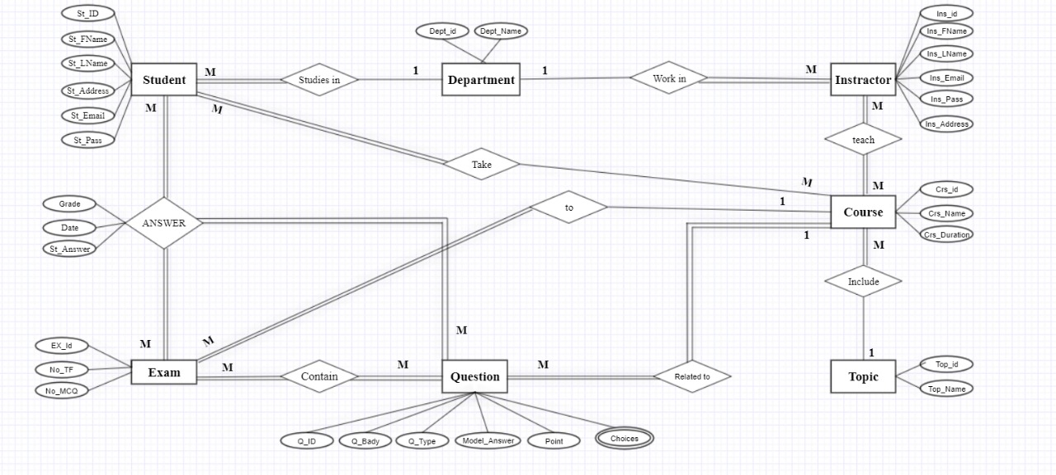
ERD

Slide 5
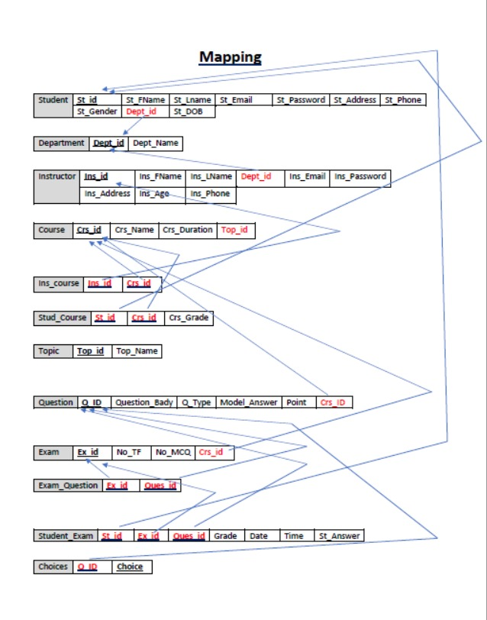
Mapping

Slide 6
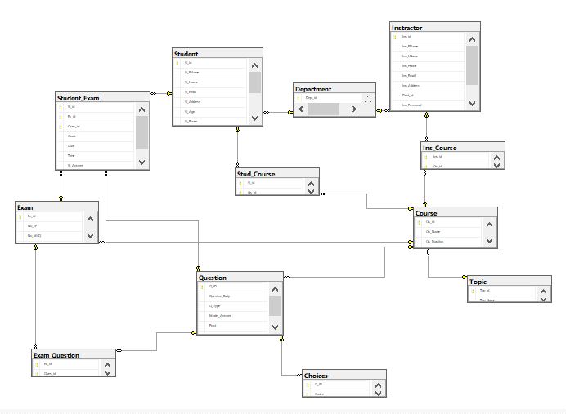
Database Diagram

Slide 7
SSRS Reports

Slide 8
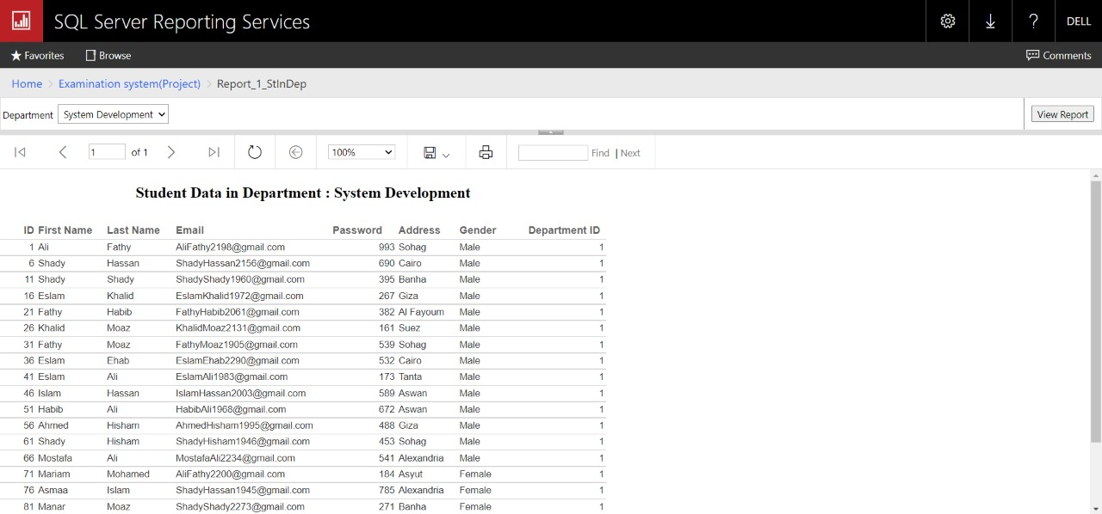
Report 1
Students information according to department name.

Slide 9
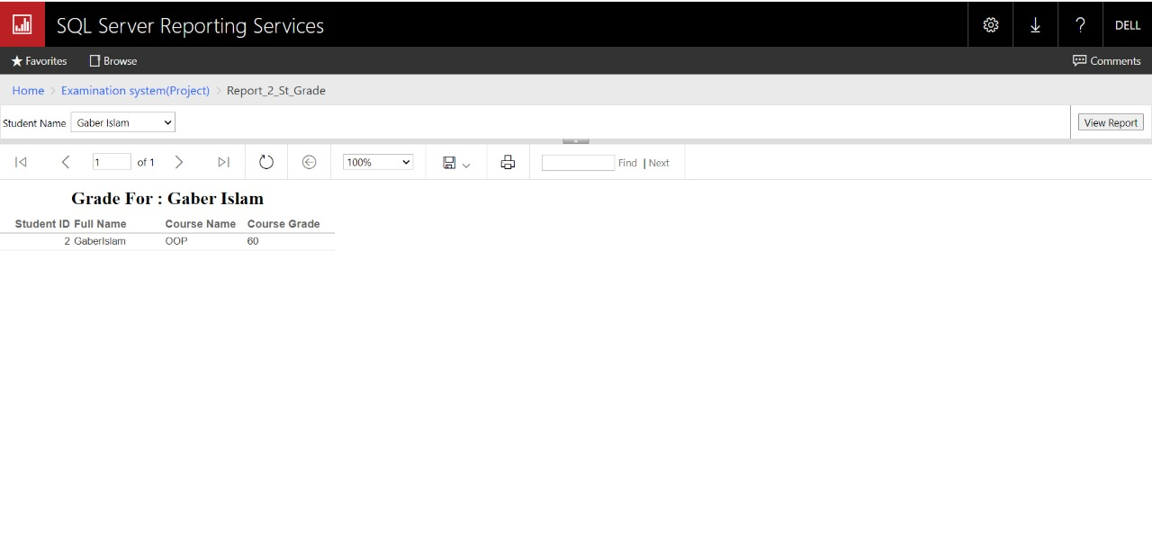
Report 2
Grades of specific student in all courses.

Slide 10
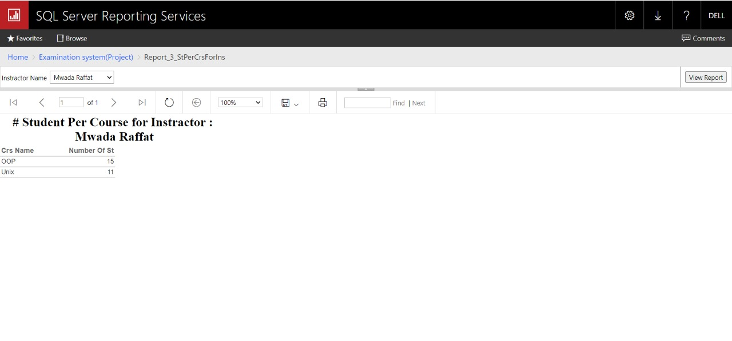
Report 3
Courses that a specific instructor teaches with number of students in it.

Slide 11
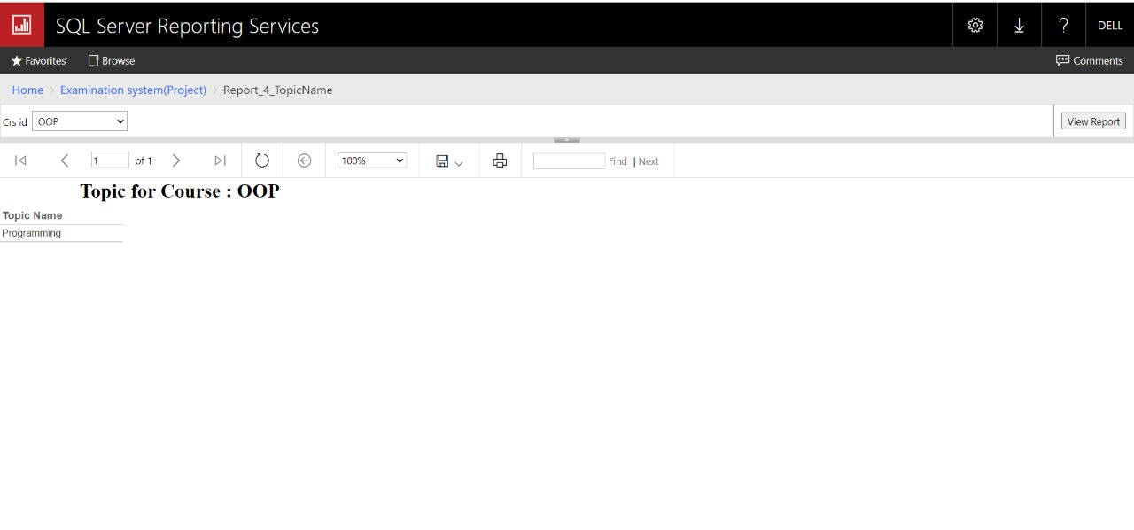
Report 4

Slide 12
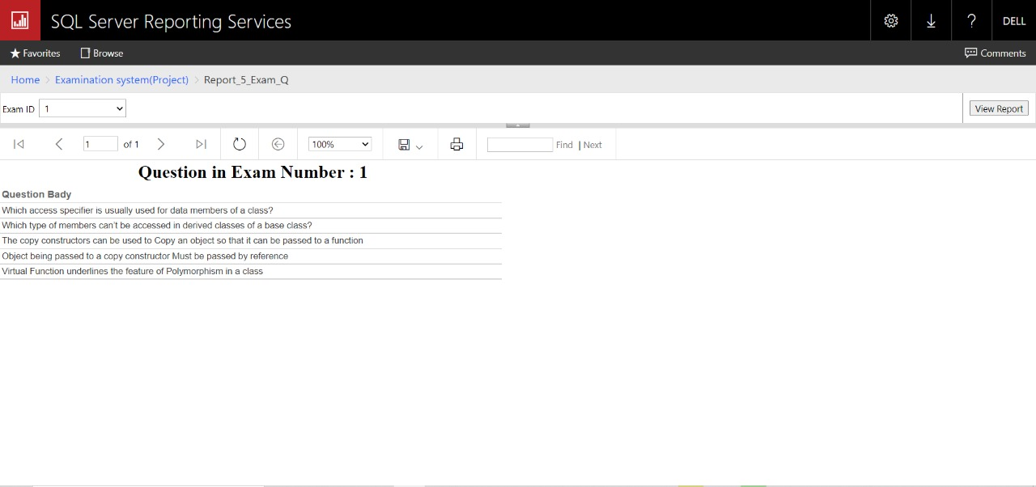
Report 5

Slide 13
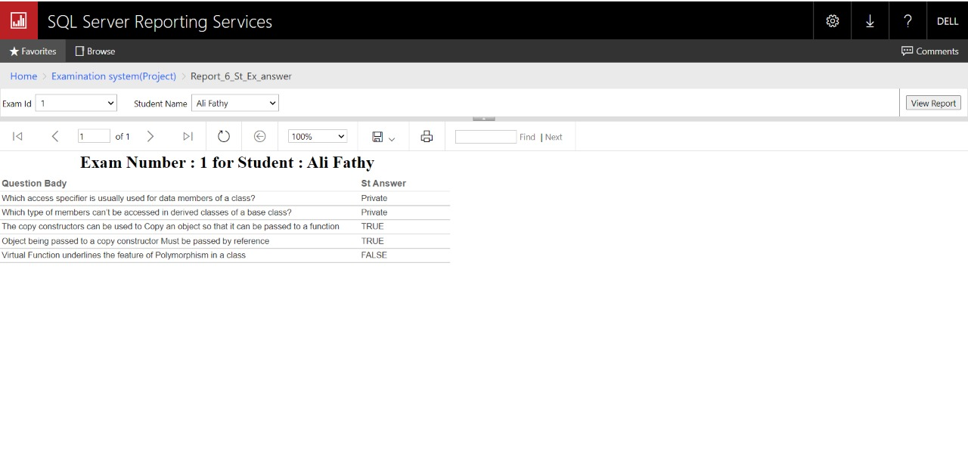
Report 6

Slide 14
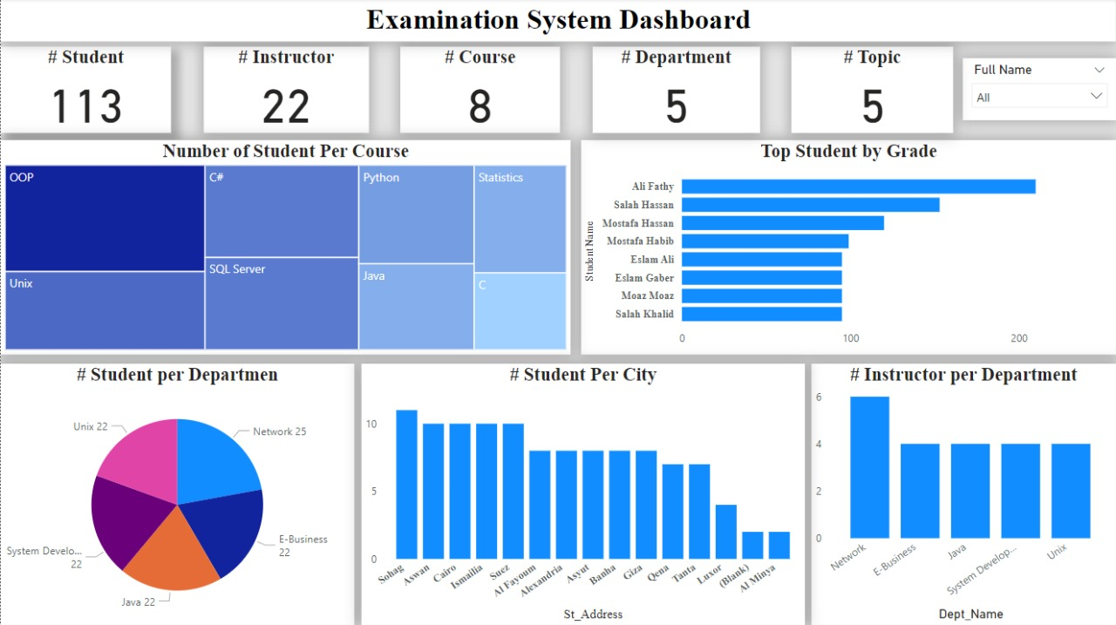
Dashboard screenshots

Slide 15
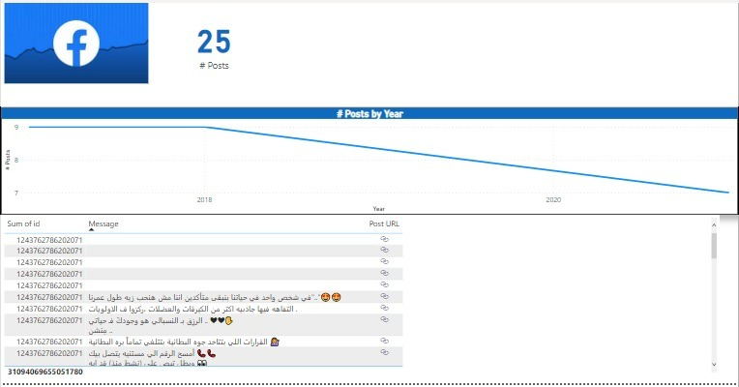
Social Media link

Slide 16
Desktop Application

Slide 17
Thank you.

